Slide 1
Waste Management
- Pranali Narkar

Slide 2
Problem statement
The United States of America is home to a variety of immigrants. With the increasing population, there are a variety of problems that need to be taken care of to have healthier communities.
There are certain flaws in the system to track problems like
Waste Collecting(on time).
Waste Recycling.

Slide 3
Proposed solution
Dustbins which are full needed to be taken care on time.
They should be sorted properly for recycling.
If any hazardous garbage should be discarded immediately.

Slide 4
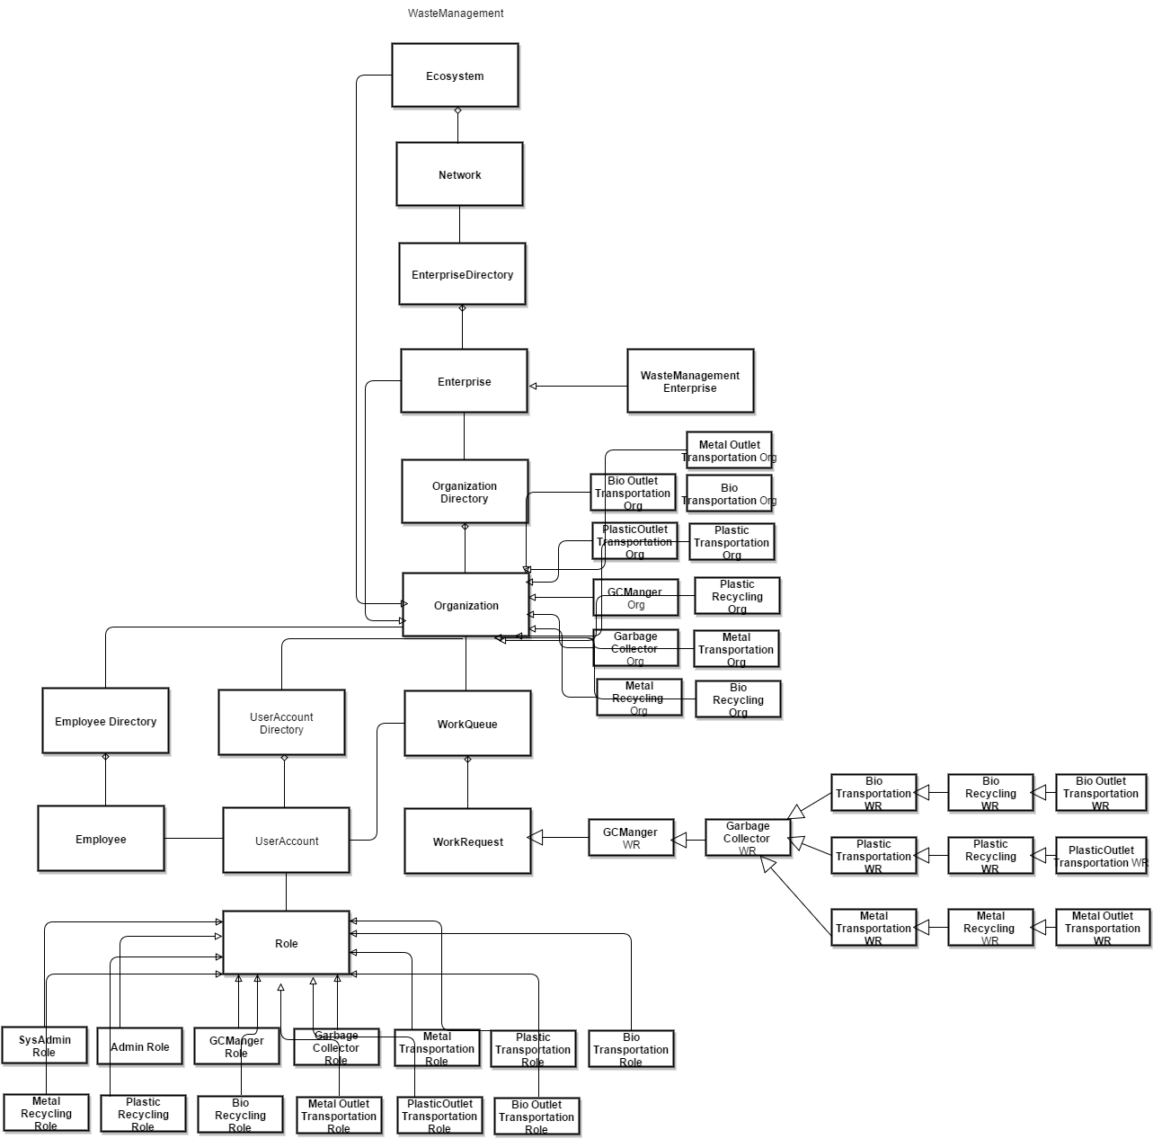
Object model

Slide 5
Major Steps involved
Employee Registration
Request from sensor data to Manager.
Graphical representation of different types of Garbage
Recycling , which is timed and temperature is automated
Transportation to different outlet.
Report send via mail after every work request is completed.
Calculation of area where the major garbage is collected, inorder to keep the work force around.

Slide 6
Use case
Improve environmental issues.
If garbage is suspected, immediate action is taken.
Transportation team is called according to the type of garbage collected.
Transportation team charges according to the kms covered.
Recycling team calculates how much garbage is collected and how much is reproduced again.
Transportation to outlet team sends the recycled waste to the outlets.
This team sends the report to the manager notifying that the request is completed.

Slide 7
Features
Implemented the concept of IOT(internet of things) to gather data and analyzing it by making use of sensors.
Classifying garbage collection request on the basis of normal or suspected.
Based on the garbage collected concern transportation team is notified.
Analyzing which area has the most garbage in order to make improvements in the working team.
Analyzing which garbage is popularly collected as well as which garbage is most useful.

Slide 8
Features continued…
Sending reports using emails after completion of request(email api).
Calculating distance travelled by the transporters using random data(math.random method).
Calculating whether the work Request completed on time inorder to improve efficiency of the team.
Generates graphical reports to show how much useful products are made out of collected garbage.

